Slide 1
PCA Face Recognition
Steven Jennings
28 March 2018

Slide 2
PART 1: Training
Vectorize training images
Calculate mean image
Calculate mean-subtracted dataset
Calculate covariance matrix
Calculate eigenvectors and eigenvalues
Calculate weights of the training dataset
It is a VERY standard approach.

Slide 3
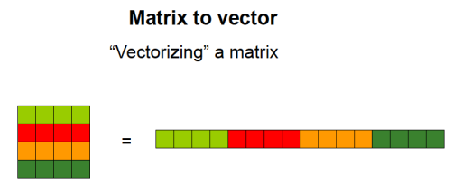
Vectorize Dataset

Slide 4
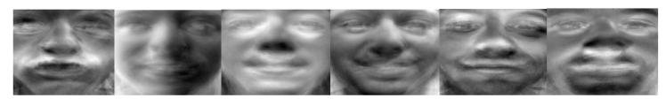
Eigenvectors and Eigenfaces
Mathematical models of a dataset

Slide 5
Important Information
Calculate the covarince matrix under REDUCED dimensionality!
  The “big” eigenvector can be extracted from the “small” covariance matrix.
PCA is a technique not unique to image processing, but useful in all signal processing.
  Voice recognition as well.
PCA is decently accurate, but not recommended for high accuracy applications like security.

Slide 6
PART 2: Testing
Vectorize test image
Project into eigenspace
Calculate differences
  Minimum euclidean distance = potential match
  “Potential match” as in, it is possible to have a false positive.

Slide 7
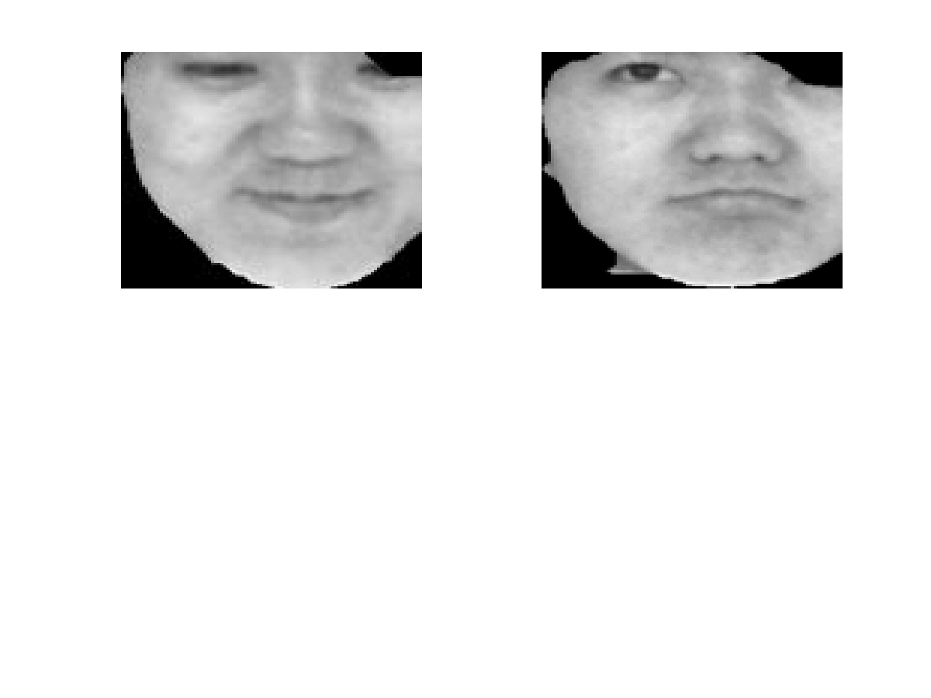
Results
First round match

Slide 8
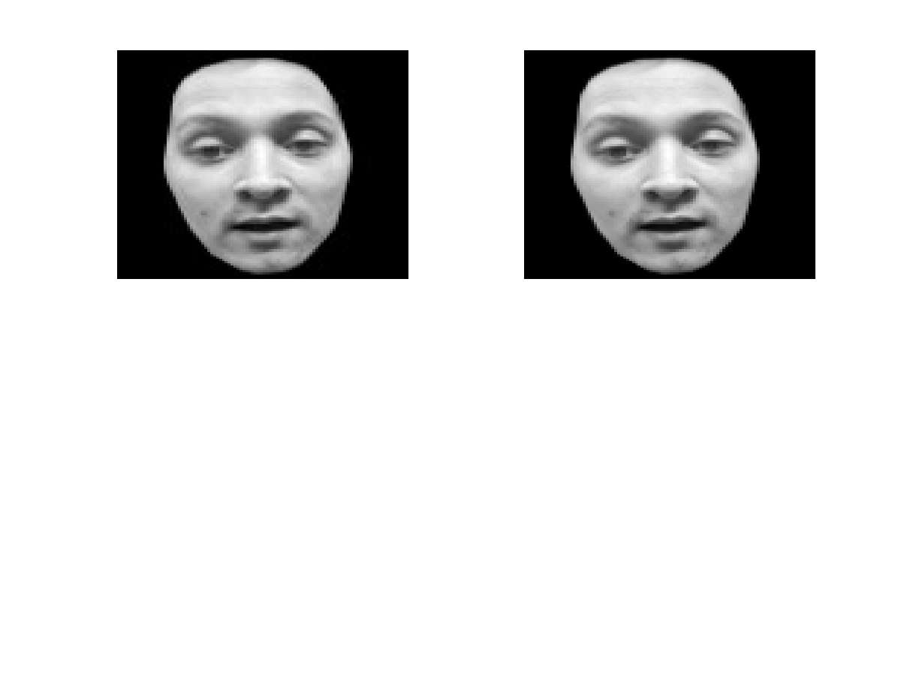
Results

Slide 9
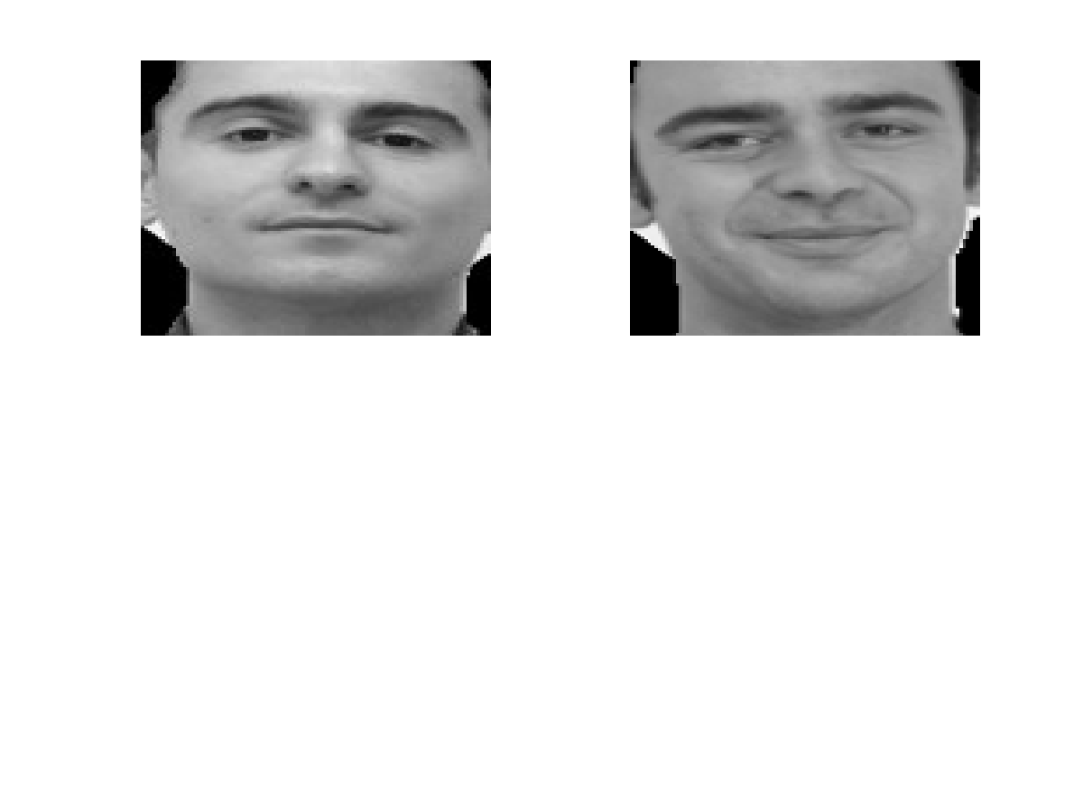
Results
FALSE POSITIVE!

Slide 10
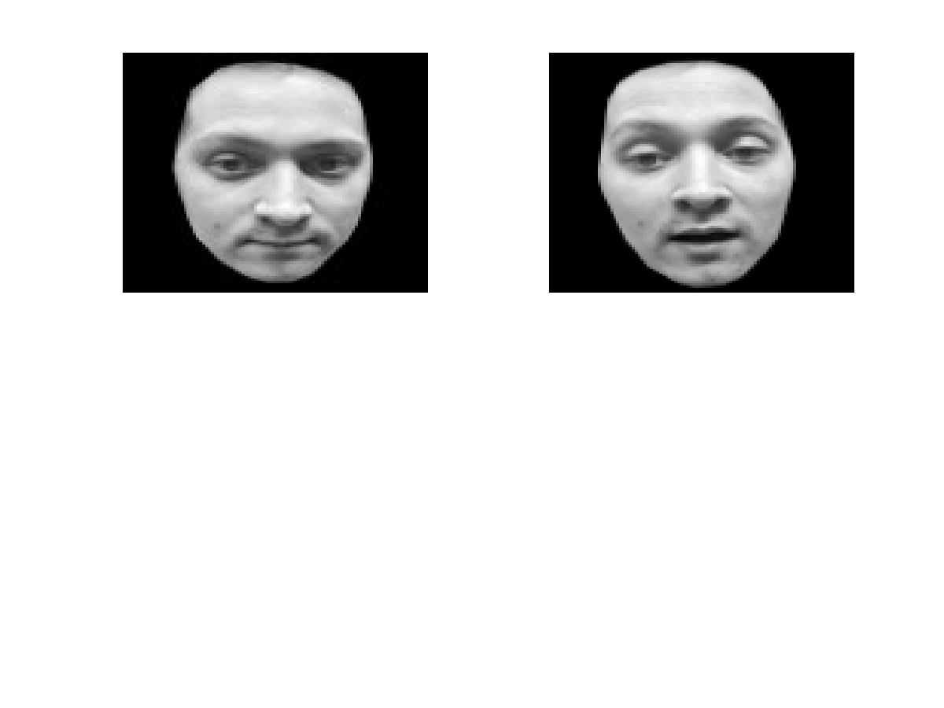
Results

